Slide 1
Suicide Prevention Outreach Trial
Pragmatic trial of two population-based outreach programs (risk assesment/care mgmt, online DBT skills)
Recruitment underway at Group Health, HealthPartners, and KPCO (KPNW to join near end of year)
Approximately 6000 enrolled (enrolling 100/week with target of 150+ per week).
Lessons/challenges:
  Epic population management tools are powerful, but complicated
  Changing culture of IRBs and DSMBs is a heavy lift – but there is progress!
  Working with health systems has been quite smooth
  Will need to re-validate outcome measures after ICD10 transition

Slide 2
Suicide Risk Calculator Project: Design
Settings
  7 health systems (Group Health, HealthPartners, Henry Ford, KP Colorado, KP Hawaii, KP Northwest, KP Southern California)
  8 million members
Visit Sample
  Age 13 or older
  Specialty MH visit OR primary care visit with MH diagnosis
Outcomes
  Encounter for self-inflicted injury/poisoning in 30, 90, or 365 days
  Death by self-inflicted injury/poisoning in 30, 90, or 365 days

Slide 3
Suicide Risk Calculator Project: Predictors
Demographics (age, sex, race/ethnicity, neighborhood SES)
MH and SUD diagnoses (current, recent, last 5 yrs)
Psychiatric medication dispensings (current, recent, last 5 yrs)
Co-occurring medical conditions (per Charlson index)
PHQ item 9 scores (current, recent, ever)
PHQ8 scores (current, recent, ever)
  Approximately 150 indicators plus 60 selected interactions

Slide 4
Sample description:
19.6 million visits for approx. 2.9 million people
51% MH specialty and 48% primary care
Race/Ethnicity: 14% Hispanic, 9% African American, 5% Asian
Insurance source: 5% Medicaid, 20% Medicare
Diagnoses: 1.5 million Bipolar Disorder, 690K Schizophrenia/Psychosis
1.9 million have PHQ item 9 score recorded
24,000 visits followed by suicide death (2108 unique events)
440,000 visits followed by suicide attempt (29,423 unique events)

Slide 5
Modelling approach:
Variable Selection
  Logistic model with penalized LASSO selection
Estimation
  Logistic model accounting for within-person clustering
Confirmation
  Calculate performance characteristics on independent sample

Slide 6
Variables selected (Group Health only):
Predicting any suicide attempt in 30 days:
63 predictors retained, top 25 listed below:
Any suicide attempt prior 3 months | Depression Dx at visit
Any suicide attempt prior 5 yrs | Traumatic brain injury Dx in prior yr
PHQ Item 9=3 at index visit | age = 13-17 * sex="F"
Drug Use Disorder Dx at index | Other Psychosis Dx in last 12 mos
Max PHQ Item 9 in prior year = 3 | Benzodiazepine fill in prior year
PHQ Item 9=2 at index visit | Self-funded insurance type
age = 13-17 | Max PHQ Item 9 in prior 1 yr = 1
Eating Disorder Dx at index | MH ED visit in prior 5 years
Any suicide attempt prior year | Alcohol Use Disorder Dx in last 12 mos
Other Psychosis Dx at index | Max PHQ Item 9 in prior 90 days = 2
Chronic pulm disease (per Charlson) | Personality Disorder Dx in last 12 mos
Bipolar Dx at index visit | PHQ Item 9=1 at index visit
Alcohol Use Disorder Dx at index

Slide 7
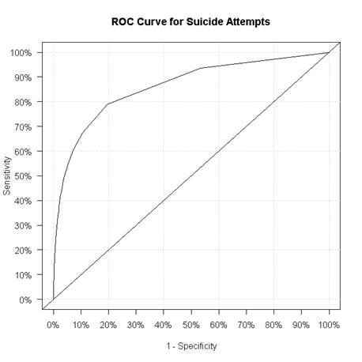
Model performance (Group Health only):

Slide 8
Predicting attempt in 30 days (Group Health only):
PHQ Item 9 vs. preliminary risk score
Model-Based Risk Score | % of Visits | Actual Risk | % of Attempts
>20% | 0.1% | 14.5% | 4%
10% to 20% | 0.3% | 12.9% | 10%
2.5% to 10% | 1.2% | 6.1% | 21%
1% to 2.5% | 1.9% | 2.2% | 13%
.2% to 1% | 29% | .46% | 40%
.1% to .2% | 52% | .07% | 11%
<.1% | 16% | .03% | 1.5%
Item 9 Score | % of Visits | Actual Risk | % of Attempts
3 | 3.5% | 2.3% | 24%
2 | 4.5% | 1.4% | 22%
1 | 16% | .72% | 24%
0 | 76% | .19% | 30%
57% missing Item 9 score:
Actual risk = .29%
47% of attempts in this group

